Slide 1
Creative Friendship and The Making of Modern art Pablo Picasso & Georges Braque
Hand in hand [Braque and Picasso] left behind the world of simple appearances. . . . The two friends worked toward the solution of the same problems, now one, now the other finding the means to achieve seemingly identical goals.
Wilhelm Uhde, 1928
Recalling the development of Cubism

Slide 2
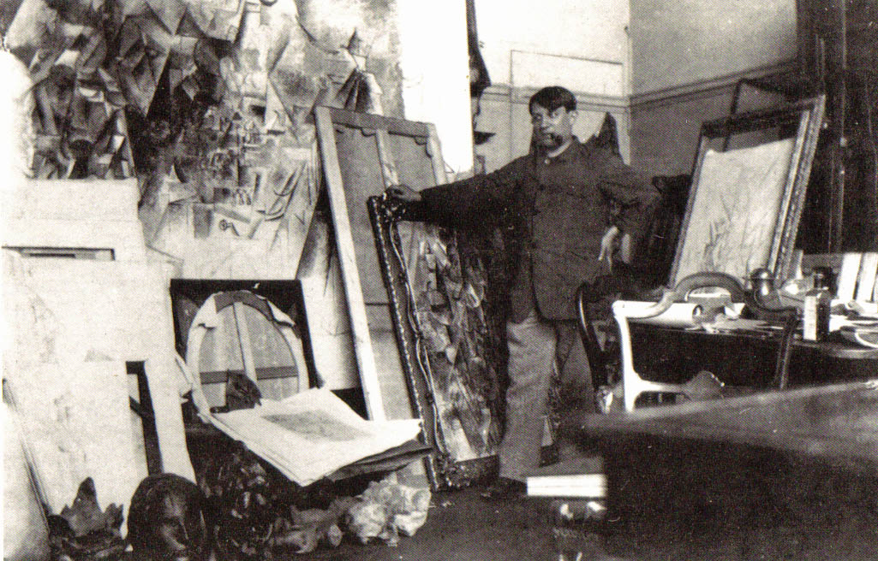
(left) Georges Braque (French, 1882-1963) in his Paris studio, early 1912 (right) Pablo Picasso (Spanish, 1881-1973) in his Paris studio, late 1911
In spite of our very different temperaments, we were guided by a common idea . . . .the differences didn’t count. . . . We lived in Montmartre, we saw each other every day, we talked. . . . It was a little like being roped together on a mountain.
Georges Braque on his friendship with Picasso
and the formulation of Cubism, 1908-1914

Slide 3
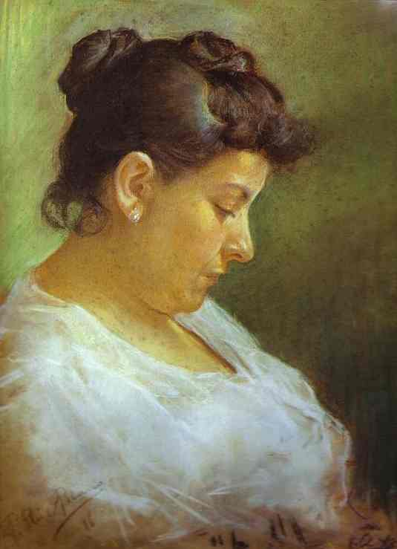
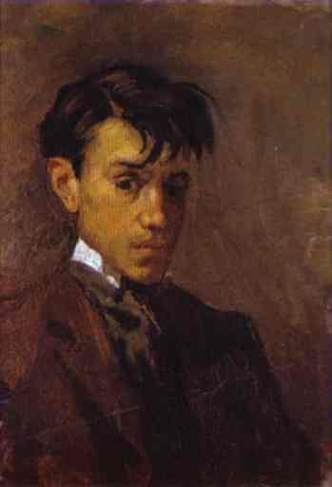
Pablo Picasso, Portrait of the Artist’s Mother, 1896 Picasso was 15 years old.
What people regard as premature genius is the genius of childhood.…
So far as I am concerned, I did not have that genius. My first drawings could never have been shown at an exhibition of children’s drawings. I lacked the clumsiness of a child, his naiveté. I made academic drawings at the age of seven, the minute precision of which frightened me.”
Picasso
Self-Portrait, 1896

Slide 4
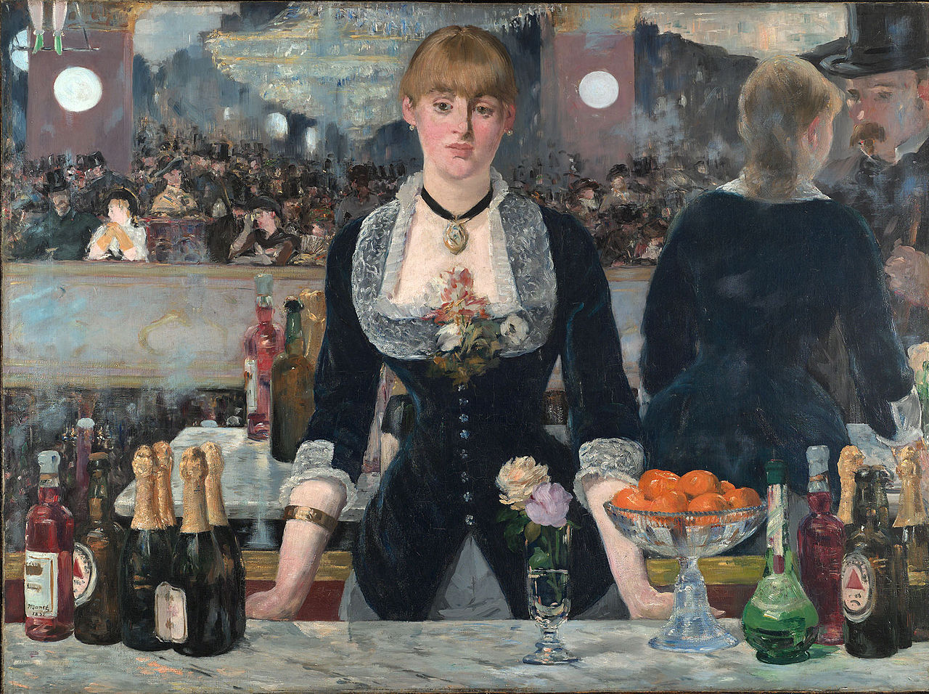
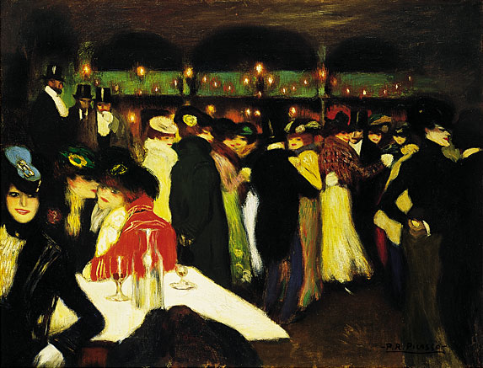
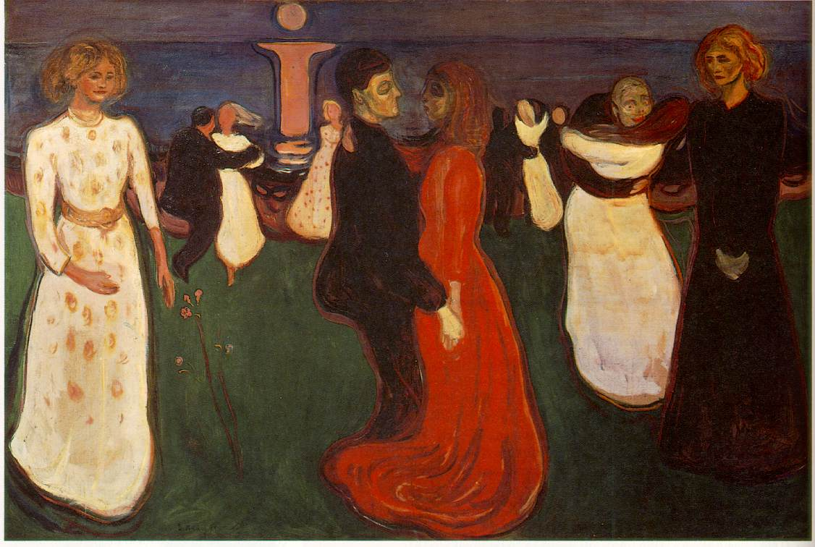
(left) Pablo Picasso, Le Moulin de la Galette, 1900, oil, 35 x 46” Parisian nightlife was a favorite subject of the avant-garde. Picasso’s is in line with the Fin de siècle “decadent” movements
Edouard Manet (French), The Bar at the Folies Bergère, 1881-2
Edvard Munch (Norwegian), The Dance of Life, 1889

Slide 5
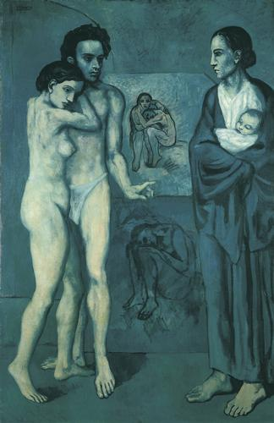
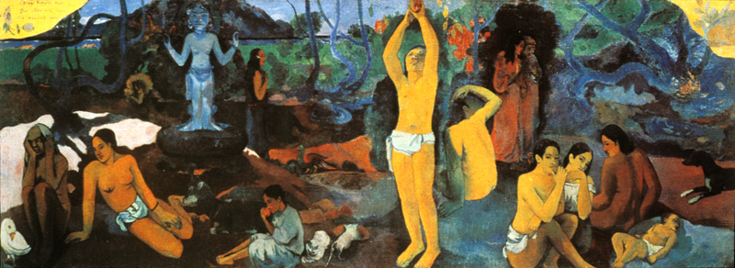
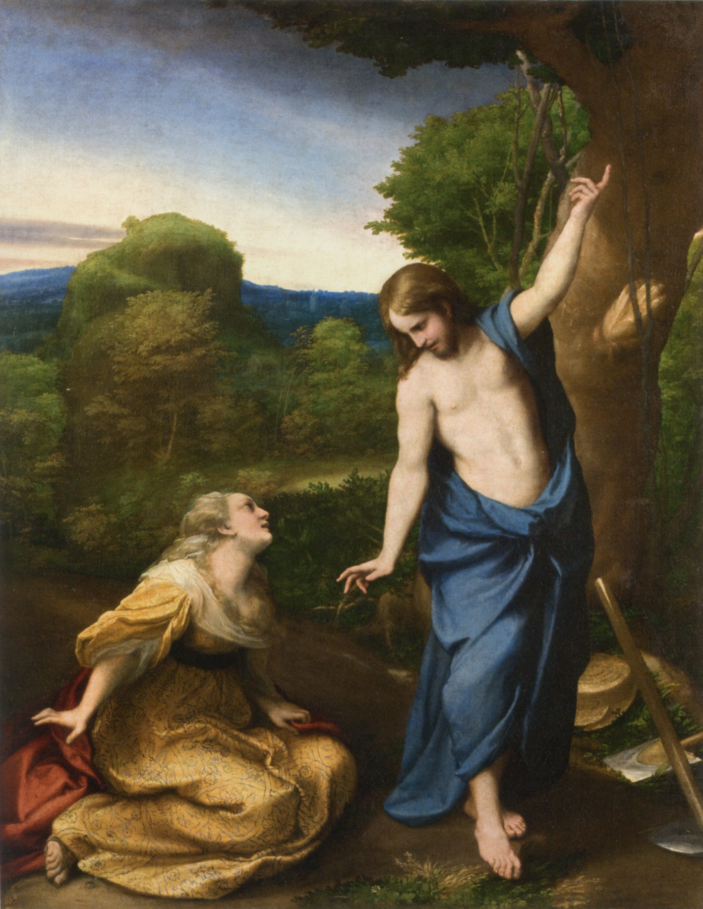
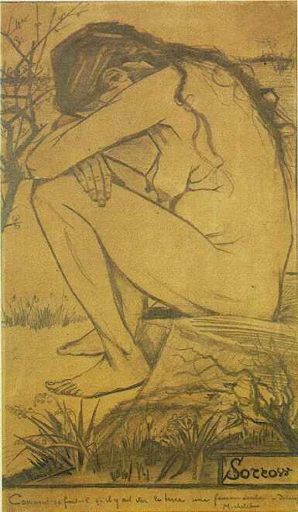
Pablo Picasso, La Vie, 1903, 6’5” x 4’2” (“Blue Period” Symbolism), painted in Barcelona Paul Gauguin, Where Do We Come From, What Are We? Where Are We Going? 1897-98, Symbolism
Noli me Tangere (touch me not) by Correggio, c. 1525, Prado museum
Sorrow, 1882 drawing by Van Gogh

Slide 6
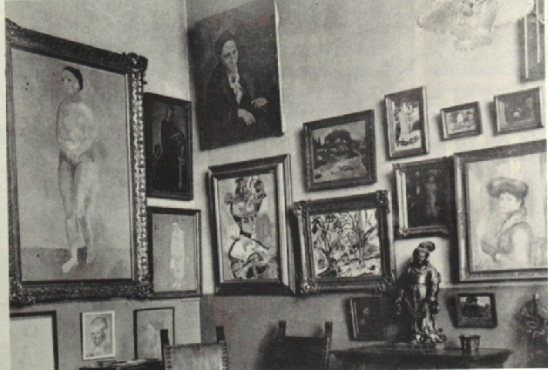
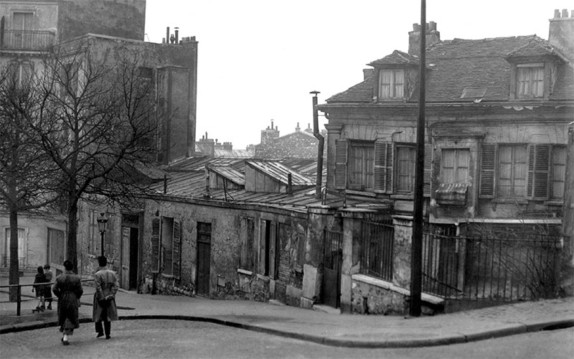
(left) Paris apartment of American expatriates Gertrude and Leo Stein, early patrons Picasso and Matisse. 27 Rue de Fleurus on the Left Bank (right) Le Bateau-Lavoir in 1910. The Bateau-Lavoir (wash houseboat) was a block of buildings in Montmartre, Paris. Picasso lived there from 1904-1909

Slide 7
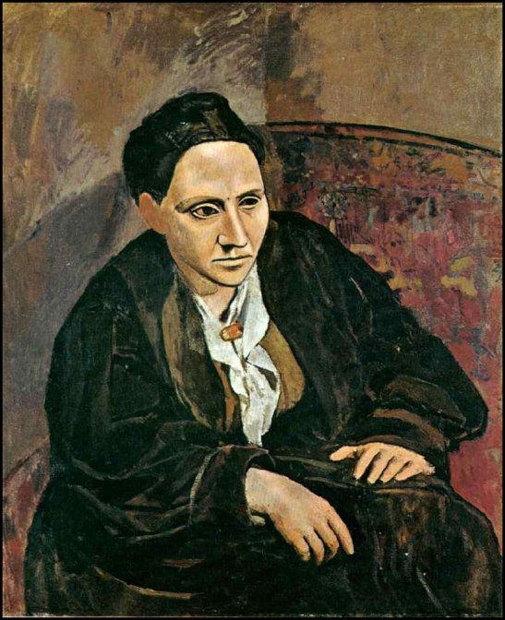
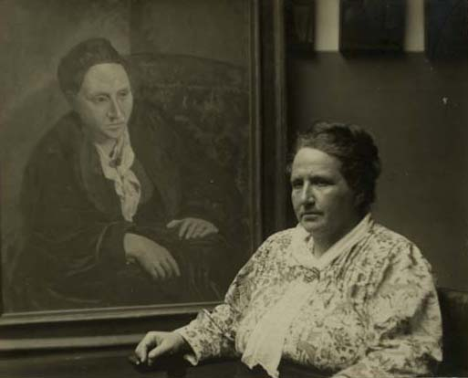
Pablo Picasso, Portrait of Gertrude Stein, oil on canvas,1906, 39 x 32” Bequest of Gertrude Stein, The Metropolitan Museum of Art, New York
“Let me recite what history teaches.
History teaches.”
http://www.talkingpeople.net/tp/literature/stein/Stein-Gertrude_If-I-Told-Him.mp3
- Gertrude Stein, Portrait of Picasso
Stein with her portrait, 1922

Slide 8
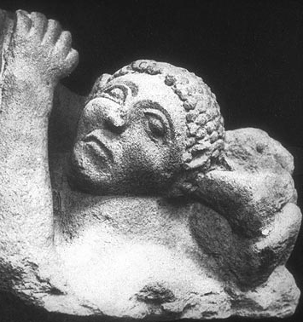
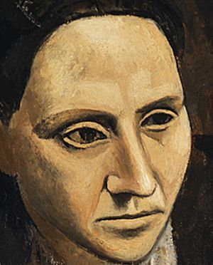
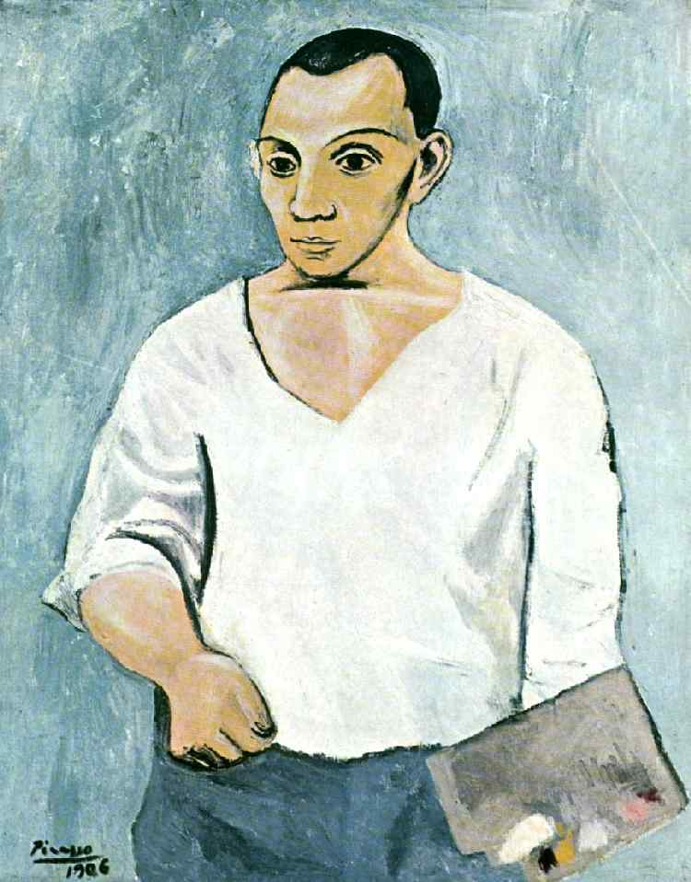
Iberian stone relief II century BCE showing facial structure of Picasso’s 1906 portraits
Detail, Gertrude Stein, 1906
Picasso, Self-Portrait, 1906

Slide 9
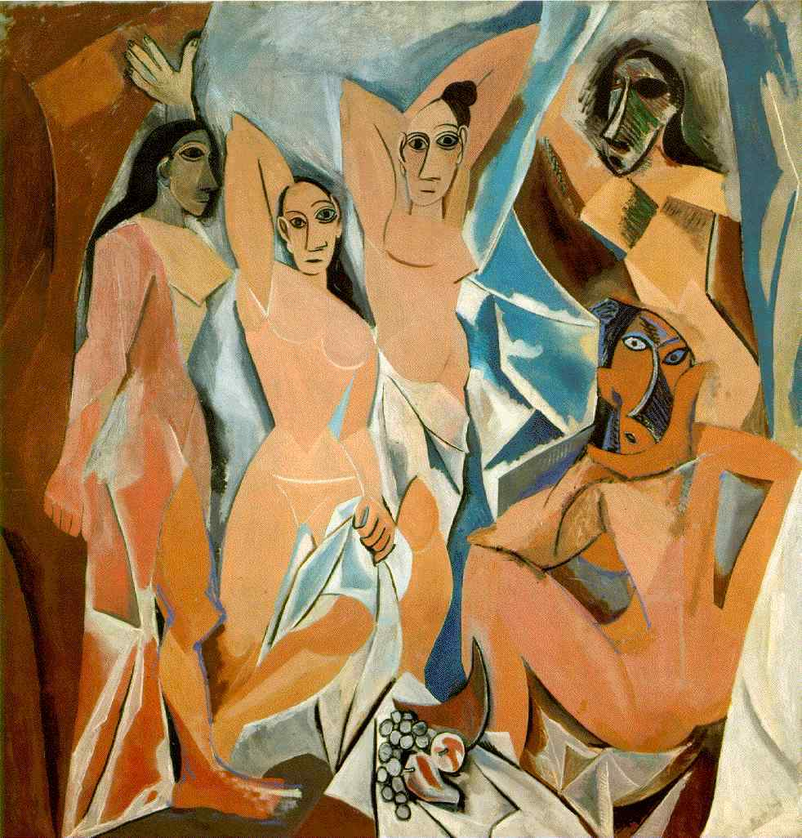
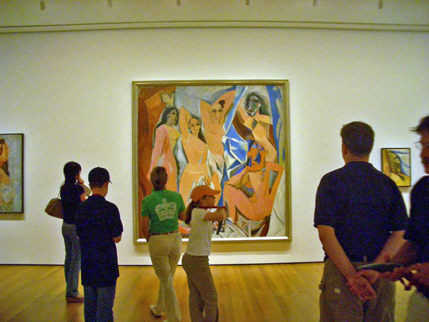
Picasso, Les Demoiselles d'Avignon, Paris, June-July 1907, oil on canvas, 8' x 7‘ 8"
Viewers at MoMA NYC

Slide 10
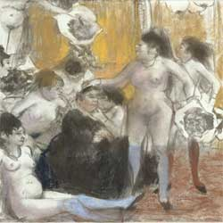
(left) Edgar Degas, Name Day of the Madame, 1889, monotype and pastel Compare with Les Demoiselles D’Avignon

Slide 11
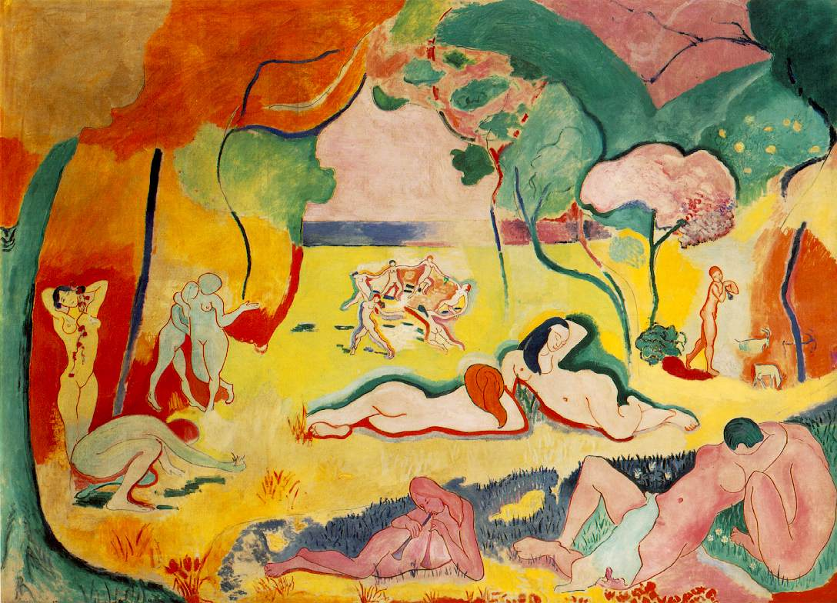
Henri Matisse, Joy of Life, 1905-06 with Demoiselles, 1907 prelapsarian and postlapsarian

Slide 12
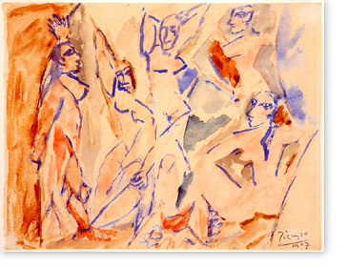
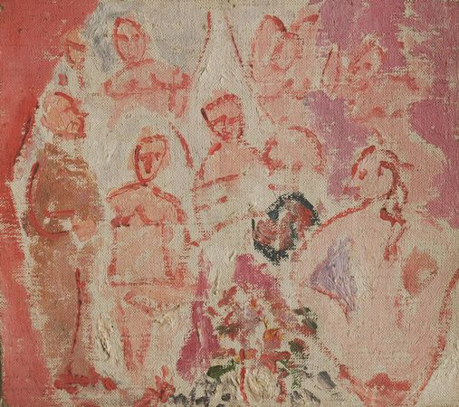
Picasso, Studies for Les Demoiselles D'Avignon, spring, 1907 (left) oil on canvas, 7 1/2 x 8“ (right) watercolor

Slide 13
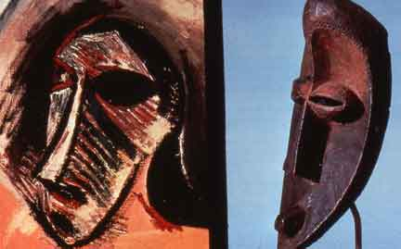
Transformative influence of African tribal sculpture Picasso’s epiphany in June 1907 at the ethnographic museum in Paris Georges Braque: “It is as if someone had drunk kerosene to spit fire."
“My first exorcism painting….
For me the masks were not just sculptures. They were magical objects...intercessors...against everything - against unknown threatening spirits....They were weapons . . . to keep people from being ruled by spirits. To help them free themselves. . . . If we give a form to these spirits, we become free."

Slide 14
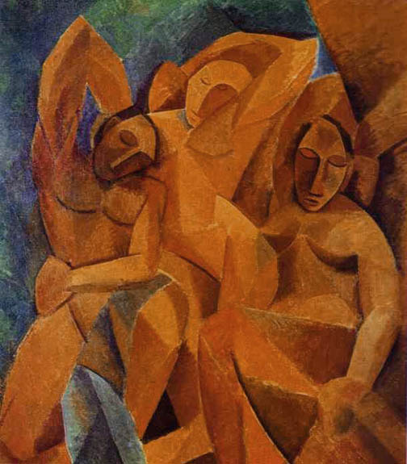
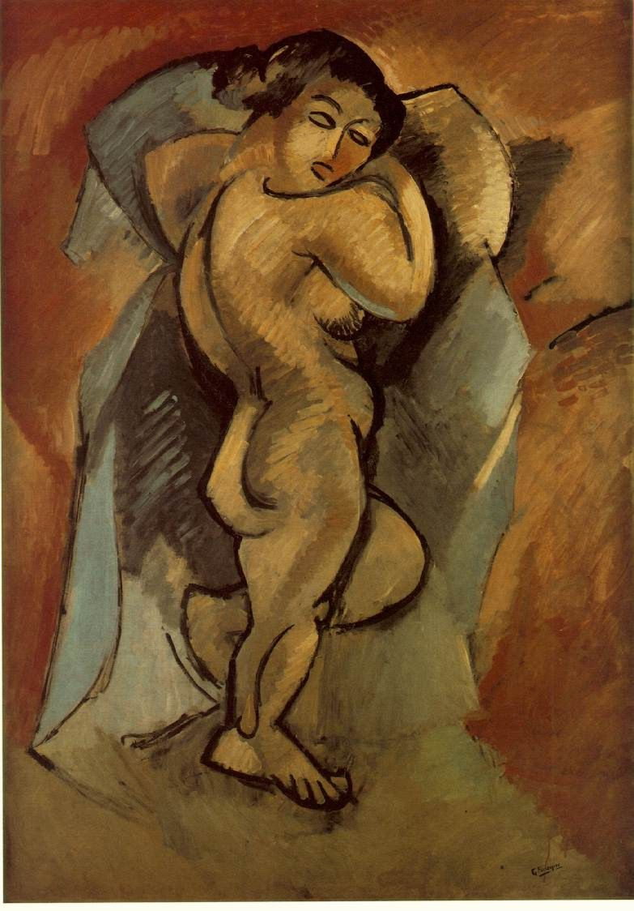
(left) Pablo Picasso, Three Women, 1907-8, oil on canvas, 6’6” x 7’6” (right) Georges Braque (French, 1882-1963), Large Nude, 1908, oil on canvas, 55” x 39” begun immediately after seeing Les Demoiselles and the first stage of Three Women.

Slide 15
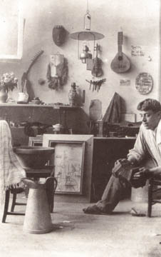
Shared Primitivism: (right) Picasso in Paris studio with African and Caledonian tribal sculptures, 1908 (left) Braque in Paris studio with African masks, 1911

Slide 16
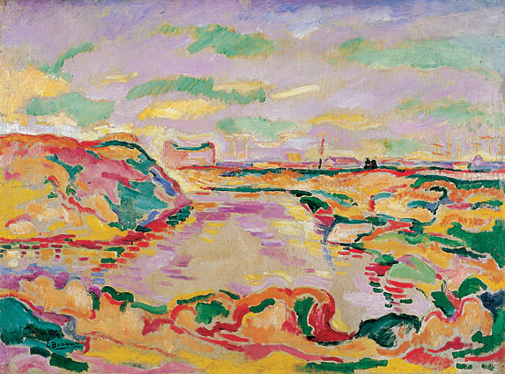
Georges Braque, Pre-Picasso Fauve painting (left) Landscape near Antwerp (Paysage près d'Anvers), 1906, oil on canvas, 24 x 32”, (right) Matissse, Le bonheur de vivre (The Joy of Life) 1905-1906, oil on canvas 69 x 95”

Slide 17
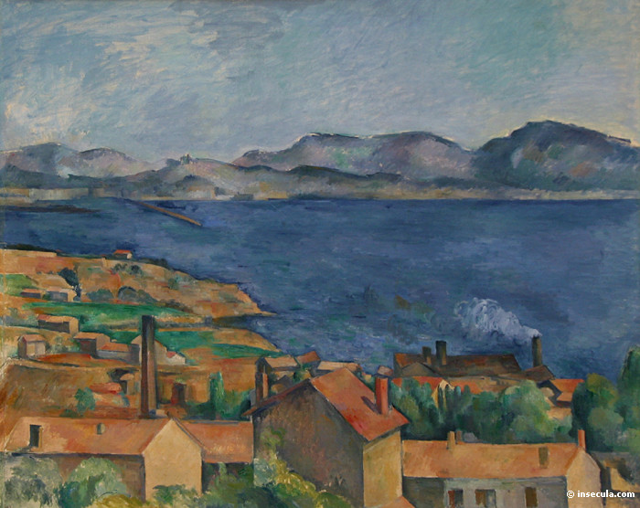
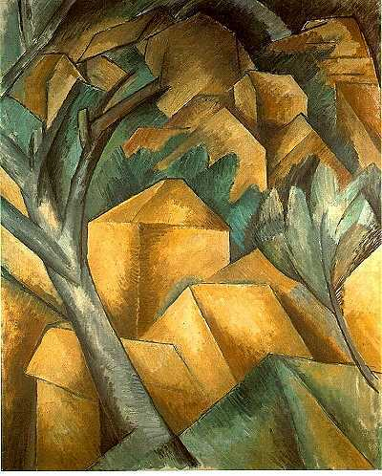
Georges Braque, Houses at L’Estaque, August 1908, oil on canvas, 28 x 23,” painted after his Large Nude (right) Paul Cézanne, The Bay from L’Estaque, oil on canvas, 31 x 38”, 1886 Braque’s Fauve palette has disappeared.
Matisse does not approve of Braque’s “little cubes,” and, as jurist for the Salon D’Automne, rejects Braque’s paintings. Cubism is named.
Picasso and Braque begin to see each other daily. Their studios are minutes apart.

Slide 18
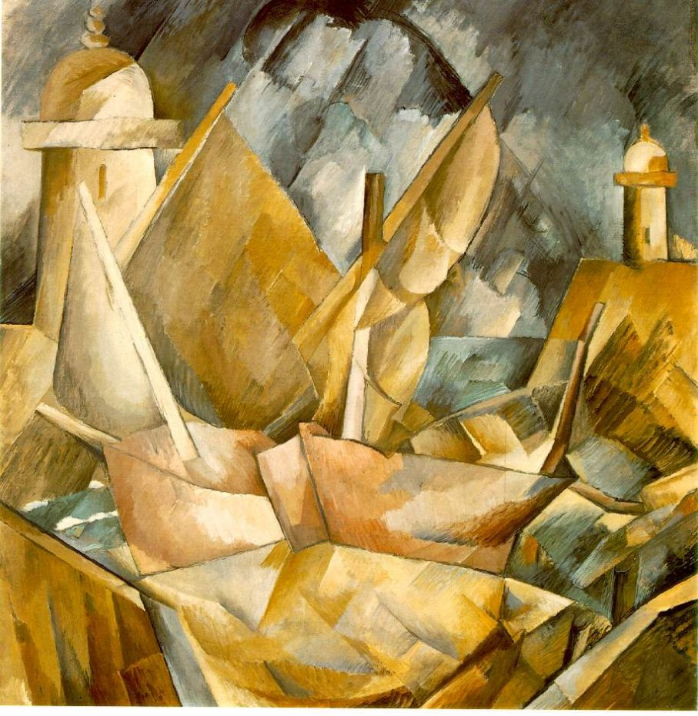
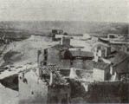
(left) Braque, Harbor in Normandy, summer 1909 (right) Picasso, Reservoir at Horta de Ebro, summer 1909 with photograph of the Spanish town by the artist (below). In 1909 Picasso and Braque stopped showing their paintings in the salons.
Arbitrary light, sculptural (limited) palette

Slide 19
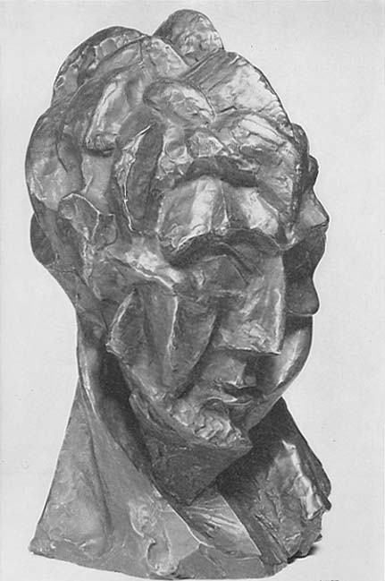
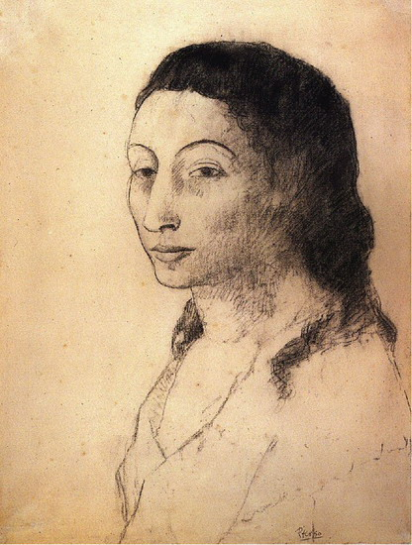
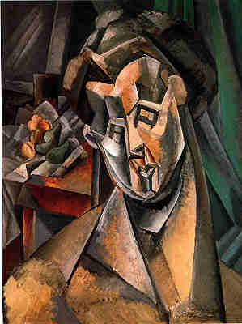
Picasso, (left) Woman's Head (Fernande), bronze, summer 1909 (center) Fernande Olivier, summer 1909 in Horta de Ebro, Spain (right) Woman with Pears, Fernande, oil on canvas, summer 1909

Slide 20
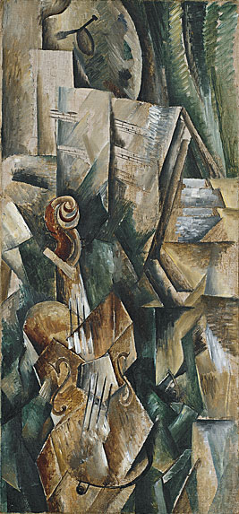
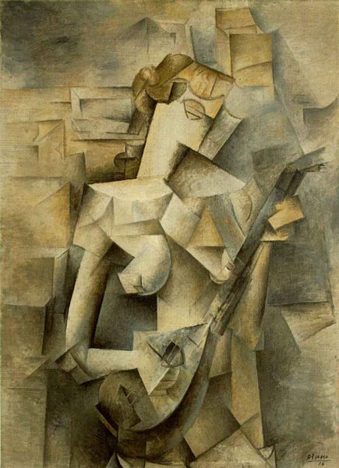
(left) Braque, Violin and Palette, autumn 1909, oil, 36 x 17” (right) Picasso, Girl with a Mandolin (Fanny Tellier), 1910
"I paint objects as I think them, not as I see them." Picasso

Slide 21
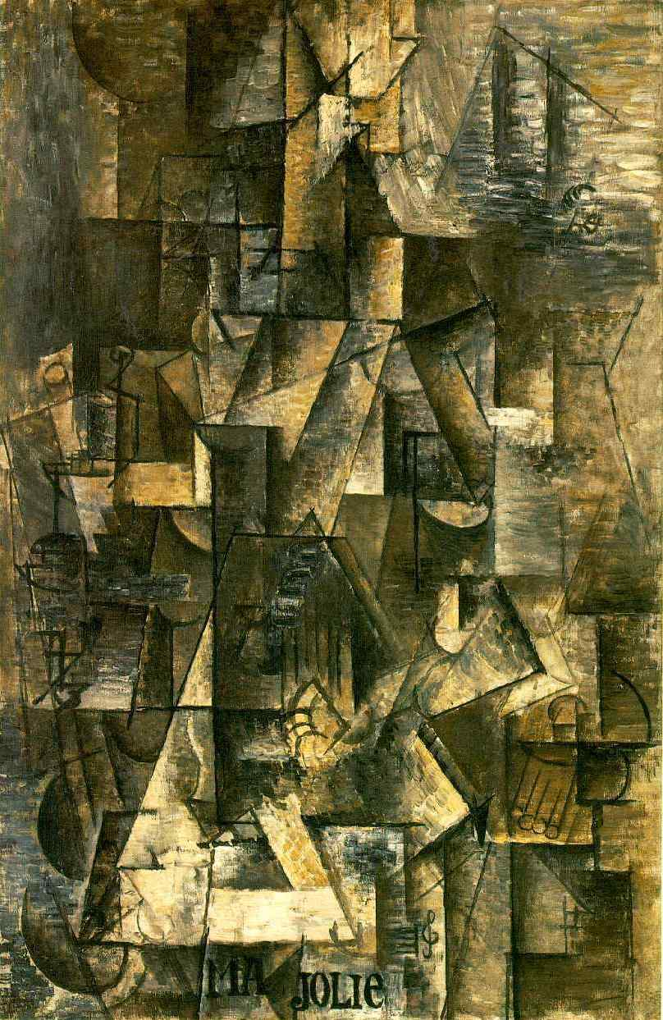
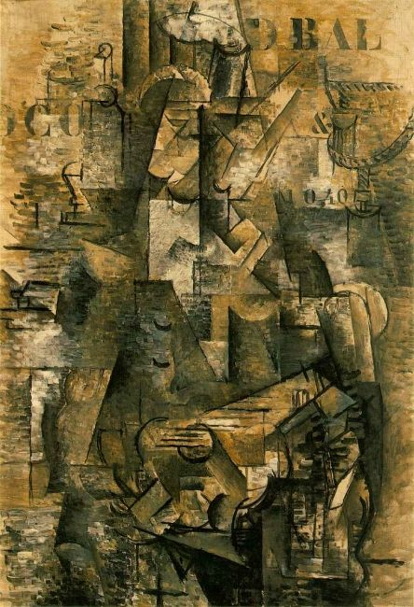
(left) Picasso, Ma Jolie (Woman with a Guitar), winter 1911-12, 40 x 26” (right) Braque, The Portuguese (The Emigrant), autumn 1911- early 1912, 46 x 32” Braque’s introduces stencil-type letters
Almost every evening, either I went to Braque’s studio or Braque came to mine. Each of us had to see what the other had done during the day. Picasso (recalling 1910-12)

Slide 22
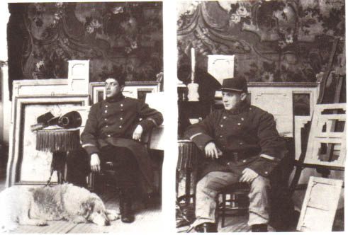
In the early days of Cubism, Pablo Picasso and I were engaged in what we felt was a search for the anonymous personality. We were inclined to efface our own personalities in order to find originality. - Braque
Georges Braque (left) and Pablo Picasso (right) wearing Braque’s military uniform, Braque’s apartment, Paris, 1911
The exchanges of 1911 and 1912 show the collaborative competition at its height.

Slide 23
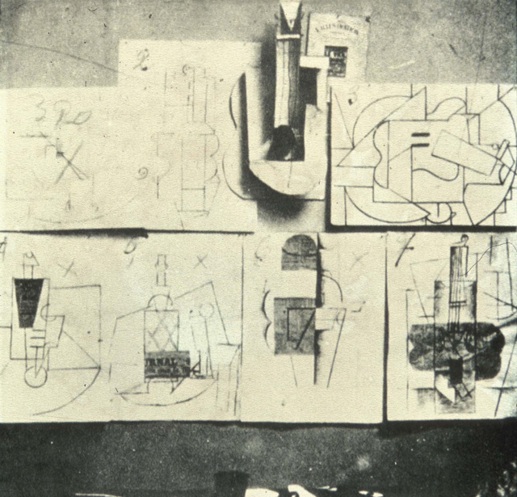
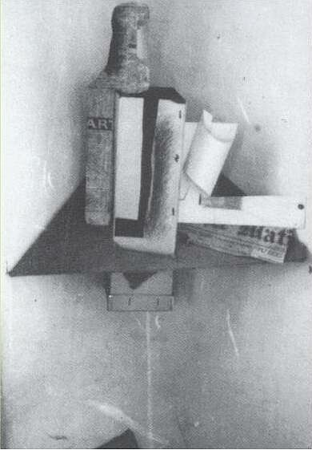
(left) Braque’s only documented paper sculpture, photographed in 1914 (right) Wall arrangement in Picasso’s studio, November-December 1912. Picasso’s cardboard guitar generated the concept of the papiers collés on the wall around it.

Slide 24
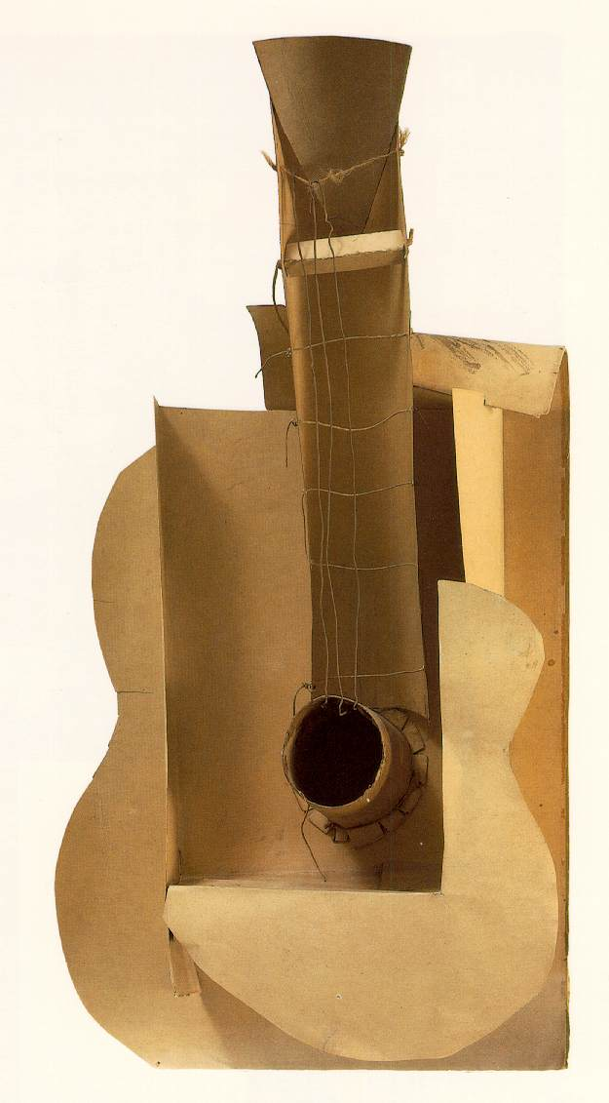
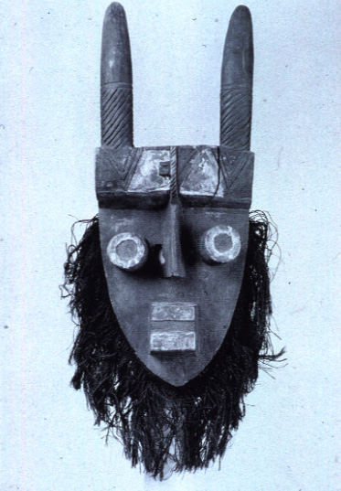
Picasso, Maquette for Guitar, October 1912, cardboard, string and wire (right) Grebo mask owned by Picasso
“You’ll see. I’m going to hold on to the Guitar, but I shall sell its plan. Everyone will be able to make it himself.”
Picasso to André Salmon

Slide 25
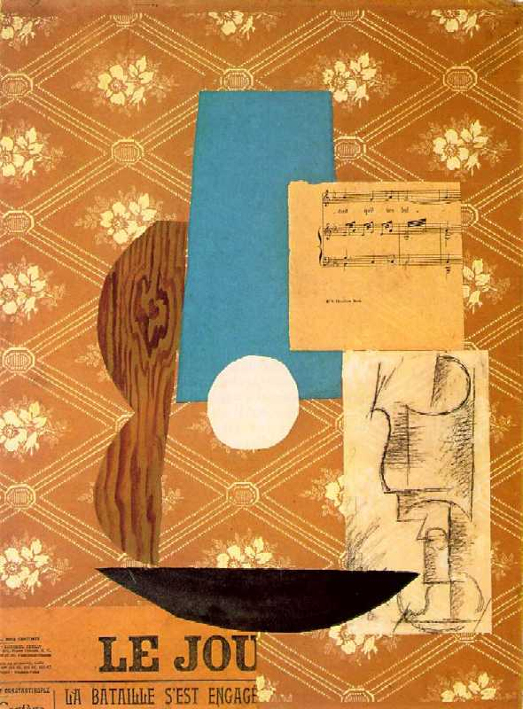
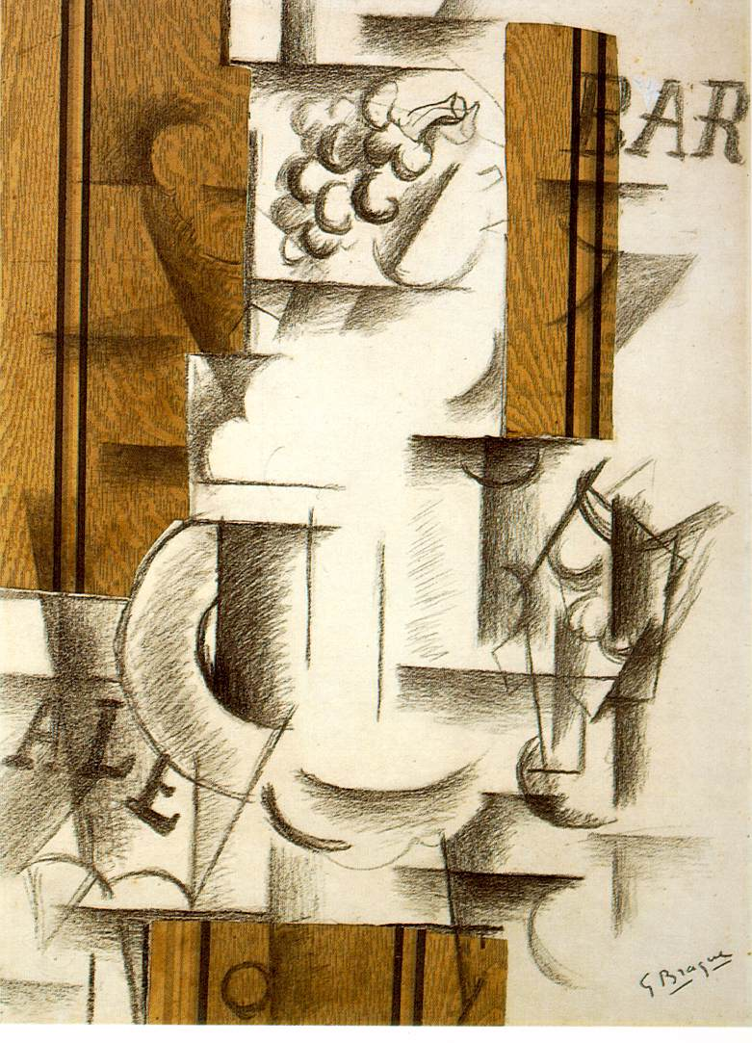
(left) Picasso, Guitar, Sheet Music and Glass, charcoal and papier collé, November 1912 (right) Braque, Fruit Dish and Glass, charcoal and papier collé, September 1912
“LA BATAILLE S’EST ENGAGÉ”: “I have to admit, that after having made the papier collé I felt a great shock, and it was an even greater shock for Picasso when I showed it to him” Georges Braque

Slide 26
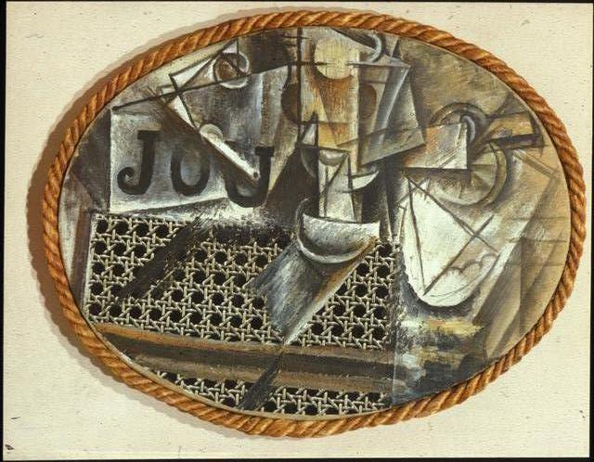
Picasso, Still life With Chair Caning, May 1912, 11 x 14” collage of oil, oil cloth, pasted paper on oval canvas surrounded by rope. First Cubist collage (not papier collé)

Slide 27
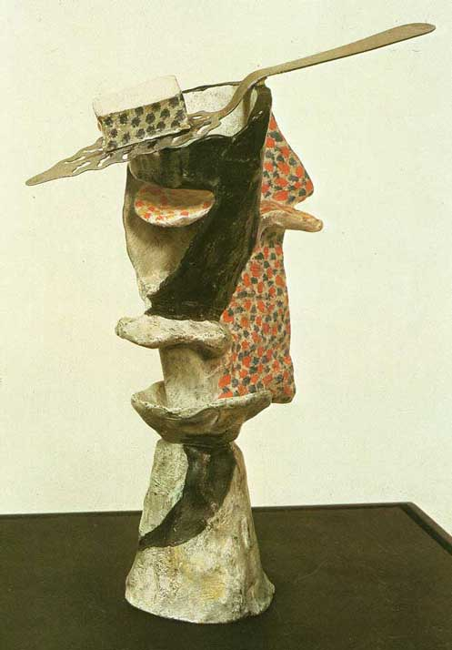
Pablo Picasso, Glass of Absinthe, spring 1914, painted bronze with perforated silver-plated absinthe spoon. Edition of six casts commissioned by dealer Kahnweiler, each painted separately

Slide 28
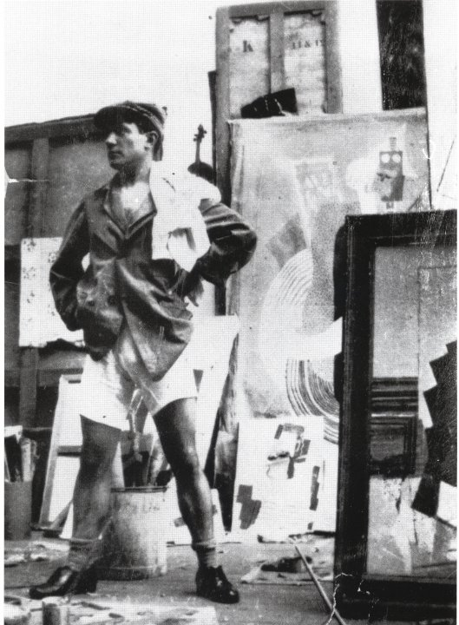
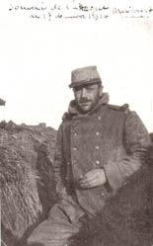
(left) Braque at the front, December 17, 1914 (center) Braque photographed by Henri Laurens in Lauren’s studio, 1915 (right) Picasso in his studio at rue Schoelcher in Montparnasse, 1914-16
“During [the Cubist] years, Picasso and I said things go one another that will never be said again . . . That no one will ever be able to understand . . . Things that would be incomprehensible, but that gave us great joy. . . . All that will end with us.”
- Braque

Slide 29
Picasso, (left) Three Women, 1921; (right) Three Musicians, 1921 After 1914 and the end of the creative dialogue with Braque, Picasso begins a dual-track (classicized realism and Synthetic Cubism) production

Slide 30
Fernand Léger, The City, 1919, 7’7” x 9’9” Philadelphia MA “Innumerable examples of rupture and change crop up unexpectedly in our visual awareness. The advertising billboard, dictated by modern commercial needs, that brutally cuts across a landscape is one of the things that has most infuriated so-called men of …. good taste.”

Slide 31
Fernand Leger's 1924 short film Ballet Mechanique.

